Slide 1
React- Context Laiba Imran

Slide 2
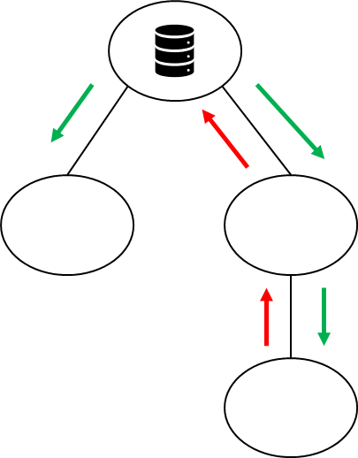
Basic State Management in React
States stored in root component
Parent passes data down to children as properties
Parent also passes callback functions to children as properties, and children can use those callbacks.

Slide 3
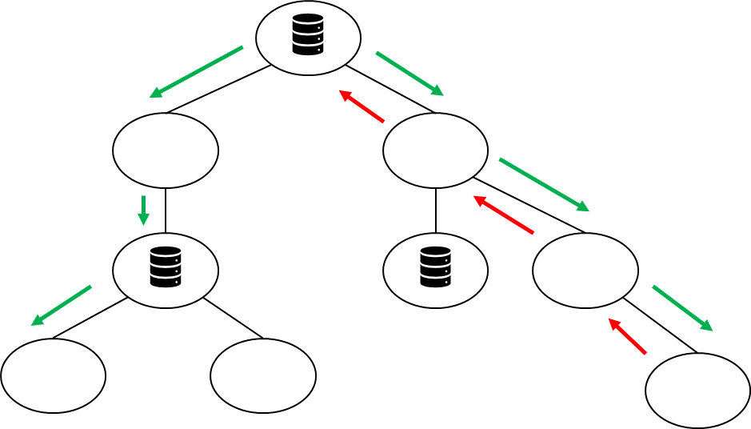
State Management Can Get Difficult and Messy

Slide 4
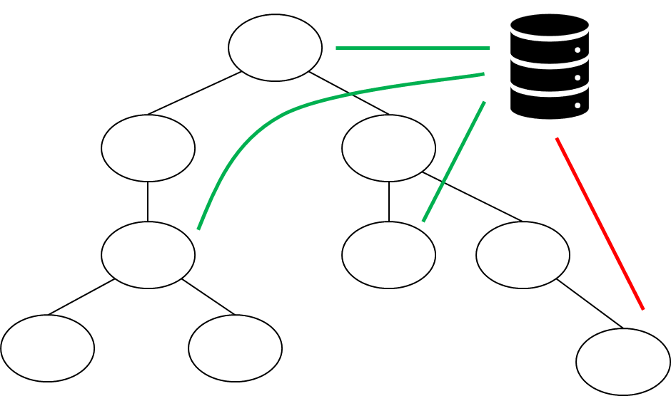
Store States in One Place

Slide 5
State Management Solutions
React Context API
Zustand
Redux
More mature and performant
More features and tool support

Slide 6
Context API
The Context API allows you to create a context, which is a centralized data store that can be accessed by any component within the provider's tree, avoiding "prop drilling" (passing props down multiple levels).
It is particularly helpful for managing global state or any state that is required by multiple components at different levels of the component hierarchy.
Theme settings, user data, and language settings that many components in an application may need to access.

Slide 7
How the Context API Works
The Context API involves creating a Context object using React.createContext().
The Context object comes with two key components: Provider and Consumer.
Provider: The Provider component provides the context to all child components. It receives a value prop, which is the data to be shared.
Consumer: Any component that needs to consume the context can use the Consumer component or the useContext hook in functional components.

Slide 8
Basic Structure: Simple counter application
import React, { createContext, useContext, useState } from 'react';
// Step 1: Create the Counter Context
const CounterContext = createContext();
// Step 2: Create the Provider Component
function CounterProvider({ children }) {
const [count, setCount] = useState(0);
const increment = () => setCount(count + 1);
const decrement = () => setCount(count - 1);
return (
<CounterContext.Provider value={{ count, increment, decrement }}>
{children}
</CounterContext.Provider>
);}
All this is to be copy pasted in the App.js file

Slide 9
Basic Structure: Simple counter application
// Step 3: Create a single Counter component that consumes the context
function Counter() {
const { count, increment, decrement } = useContext(CounterContext);
return (
<div >
<h1> {count} </h1>
<button onClick={increment}>Increment</button>
<button onClick={decrement}>Decrement</button>
</div>
);}
// Step 4: Use the Provider in the App component
export default function App() {
return (
<CounterProvider>
<Counter />
</CounterProvider>
);}
All this is to be copy pasted in the App.js file, it is the continuation of previous slide.
Click to see the results of above code
https://codesandbox.io/p/sandbox/tty55g?file=%2Fsrc%2FApp.js%3A1%2C1-16%2C2

Slide 10
Avoiding Prop Drilling
In a larger app, it’s common to have deeply nested components.
If multiple nested components need access to a shared state (like count in our example), we would have to pass count and its updating functions (increment and decrement) through several layers of components as props.
This process is called prop drilling and can get messy as your app grows. Each intermediate component has to accept and pass down props it doesn’t even use, just to reach the components that do need them.

Slide 11
With Context API
We can define the state and functions in a single place (like CounterProvider), and any component that needs access to count, increment, or decrement can get it directly, without involving unrelated components.

Slide 12
Basic Structure: User Authentication Context
import React, { createContext, useContext, useState } from 'react';
// Create a User Context
const UserContext = createContext();
// Provider Component
export function UserProvider({ children }) {
const [user, setUser] = useState(null);
const login = (userInfo) => setUser(userInfo);
const logout = () => setUser(null);
return (
<UserContext.Provider value={{ user, login, logout }}>
{children}
</UserContext.Provider>
);}
All this is to be copy pasted in the App.js file.

Slide 13
Basic Structure: User Authentication Context
// Component that consumes User Context
function UserProfile() {
const { user, logout } = useContext(UserContext);
return (
<div>
{user ? (
<>
<h1>Welcome, {user.name}</h1>
<button onClick={logout}>Logout</button>
</>
) : (
<p>Please log in</p>)}
</div>);}
export default function App() {
return (
<UserProvider>
<UserProfile />
</UserProvider>
);}
All this is to be copy pasted in the App.js file, it is the continuation of previous slide.

Slide 14
Zustand State Management

Slide 15
Zustand
Zustand is a state management library for React applications that provides a simplified and scalable way to manage complex state.
Zustand provides a store that holds the state of your application. The store can be accessed from any component using a custom hook, which allows for updates to the state whenever it changes.
It doesn’t rely on React Context, which means you can avoid performance issues related to React’s Context API.
npm install zustand
Notes:
It allows for simple and flexible state updates. You can create custom hooks to access and update state in a very straightforward manner.

Slide 16
Basic Usage: Simple Counter Step 1
// store.js
import create from 'zustand';
// Create the Zustand store
export default const useStore = create((set) => ({
count: 0,
increment: () => set((state) => ({ count: state.count + 1 })),
decrement: () => set((state) => ({ count: state.count - 1 })),
}));
All this is to be copy pasted in the store.js file.

Slide 17
Basic Usage: Simple Counter Step 2
// Counter.js
import React from 'react';
import useStore from './store';
export default const Counter = () => {
// Access count, increment, and decrement from the Zustand store
const { count, increment, decrement } = useStore();
return (
<div >
<h1>Count: {count}</h1>
<button onClick={increment} >
Increment
</button>
<button onClick={decrement}>
Decrement
</button>
</div>
);};
All this is to be copy pasted in the Counter.js file.

Slide 18
Basic Usage: Simple Counter Step 3
// App.js
import React from 'react';
import Counter from './Counter';
export default const App = () => {
return (
<div>
<h1>Simple Counter with Zustand</h1>
<Counter />
</div>
);
};
All this is to be copy pasted in the App.js file.

Slide 19
Context API vs Zustand
The Context API can cause unnecessary re-renders because any change in context value triggers a re-render for all components consuming that context.
Zustand, on the other hand, updates only the components that need specific pieces of state, resulting in better performance.

Slide 20
Context API
import React, { createContext, useContext, useState } from 'react';
const AppContext = createContext();
const AppProvider = ({ children }) => {
const [count, setCount] = useState(0);
const [text, setText] = useState("Hello");
return (
<AppContext.Provider value={{ count, setCount, text, setText }}>
{children}
</AppContext.Provider>
);
};
All this is to be copy pasted in the App.js file.

Slide 21
Context API
const useAppContext = () => useContext(AppContext);
// CountDisplay Component (only cares about count)
const CountDisplay = () => {
const { count } = useAppContext();
return <div>Count: {count}</div>;
};
// TextDisplay Component (only cares about text)
const TextDisplay = () => {
const { text } = useAppContext();
return <div>Text: {text}</div>;
};
All this is to be copy pasted in the App.js file, it is the continuation of previous slide.

Slide 22
Context API
All this is to be copy pasted in the App.js file, it is the continuation of previous slide.
const Main = () => {
const { setCount, setText } = useAppContext();
return (
<div>
<CountDisplay />
<TextDisplay />
<button onClick={() => setCount((prev) => prev + 1)}>Increment Count</button>
<button onClick={() => setText("World")}>Change Text</button>
</div>
);
};
export default const App = () => (
<AppProvider>
<Main />
</AppProvider>
);

Slide 23
Zustand
import create from 'zustand';
const useStore = create((set) => ({
count: 0,
text: "Hello",
increment: () => set((state) => ({ count: state.count + 1 })),
setText: (newText) => set({ text: newText }),
}));
// CountDisplay Component (only cares about count)
const CountDisplay = () => {
const count = useStore((state) => state.count);
return <div>Count: {count}</div>;
};
All this is to be copy pasted in the App.js file.

Slide 24
Zustand
// TextDisplay Component (only cares about text)
const TextDisplay = () => {
const text = useStore((state) => state.text);
return <div>Text: {text}</div>;
};
export default const App = () => {
const increment = useStore((state) => state.increment);
const setText = useStore((state) => state.setText);
return (
<div>
<CountDisplay />
<TextDisplay />
<button onClick={increment}>Increment Count</button>
<button onClick={() => setText("World")}>Change Text</button>
</div>
);
};
All this is to be copy pasted in the App.js file, it is the continuation of previous slide.

Slide 25
Resources
Go over
https://luqmanshaban.medium.com/react-context-api-a-step-by-step-guide-8dec066fcdaf
https://refine.dev/blog/usecontext-and-react-context/#set-up-the-project
https://zustand-demo.pmnd.rs/
https://medium.com/@onix_react/zustand-state-management-for-react-feef64b2555e
https://zustand.docs.pmnd.rs/getting-started/introduction

